Slide 1
Empathy
vs
Sympathy
Emmanuel Collado

Slide 2
Often confused?
Both of the words deal with the relationship a person has to the feelings and experiences of another person. So, let’s explore the differences between these terms and how they are most commonly used.

Slide 3
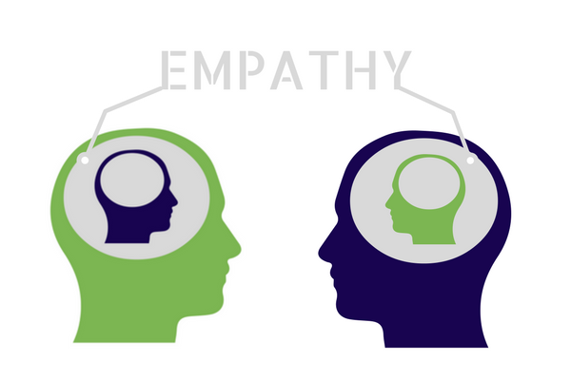
01
Empathy
You have empathy for a person when you can imagine how they might feel based on what you know about that person, despite not having those feelings explicitly communicated.
Someone has empathy if they can put themselves in the same situation and perceive how the other person is feeling, even if they do not share those feelings.

Slide 4
Examples of empathy
That would frustrate me, too.
I would feel bad in that situation too.

Slide 5
02
Sympathy
Sympathy (‘fellow feeling’, ‘community of feeling’) is a feeling of care and concern for someone, often someone close, accompanied by a wish to see him better off or happier. Compared to pity, sympathy implies a greater sense of shared similarities together with a more profound personal engagement.

Slide 6
Examples of empathy
I’m sorry for your loss.
I apologize for that. I know you are suffering.

Slide 8
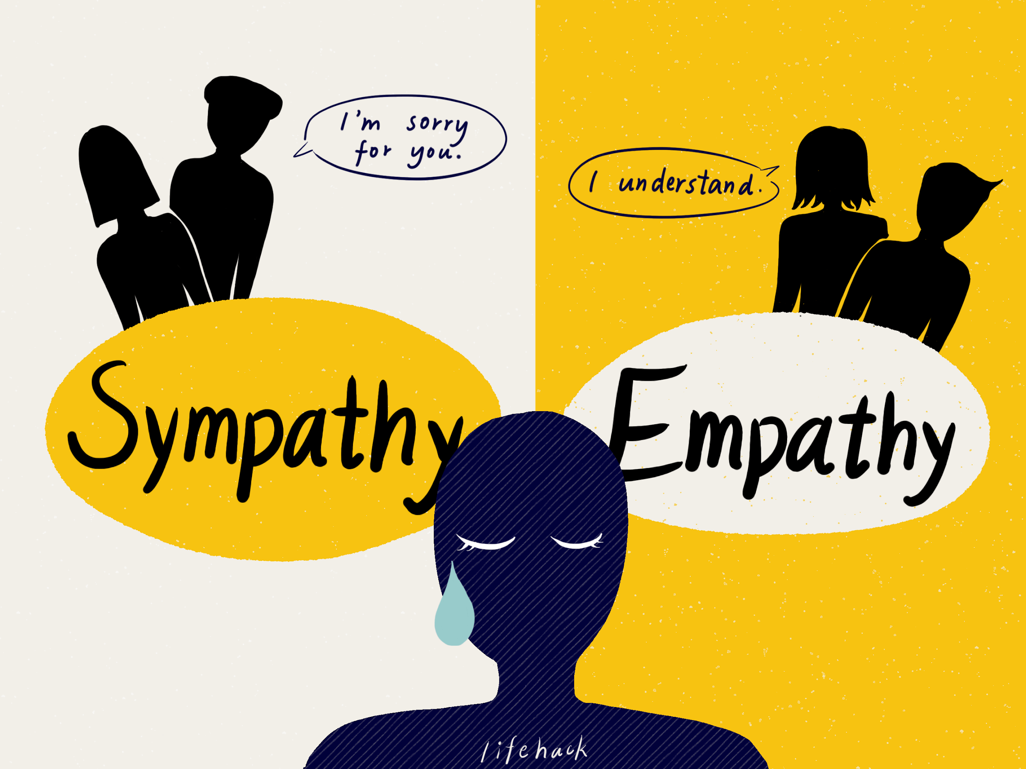

Slide 9
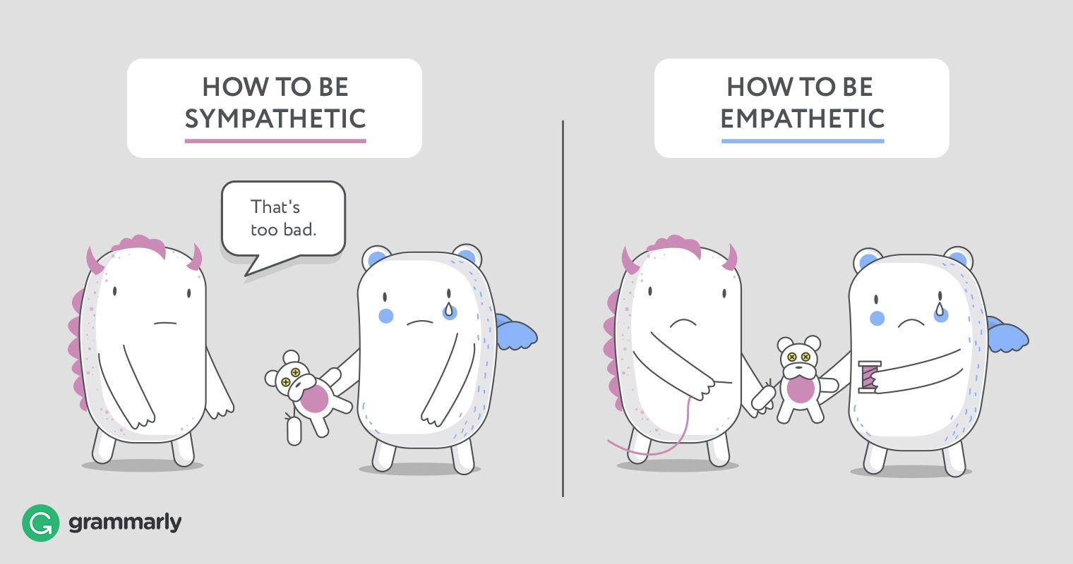

Slide 10
Steps to create empathy statements
ACKNOWLEDGE → Perspective Taking, or putting yourself in someone else’s shoes.
EMPATHIZE → Staying out of judgement and listening. Recognizing emotion in another person that you have maybe felt before. Communicating that you can recognize that emotion.
REASSURE → Find a resolution for the problem by working things out WITH the person.

